Slide 1

Paper Topic Classification
with Active Learning
Daehyun Cho
Cognitive System Lab
A.I. Dept, Korea Univ.
2021-10-13
1

Slide 2

Index
1
Project Plan
2
Motivation
3
Related Works
4
Contribution
+
Backups
Cogsys Lab

Slide 3
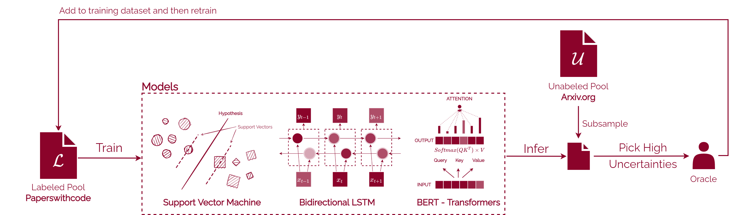
Whole Pipeline Blueprint
※ Some conditions may change during the project
1
Project Plan
Cogsys Lab, Daehyun Cho

Slide 4
Multi-label Classification Problem with Paper Title+Abstract
Data
paperswithcode: contains 12k papers from A.I. Field
arxiv: contains 1.7M papers from many fields – will use A.I. related only
Task
A.I. Field Multi-label Classification
Active Learning with Labeled Pool (paperswithcode) and Unlabeled Pool (arxiv)
Details
Uncertainty-based sampling methods
Classic Active Learning / BALD / BatchBALD
Uncertainty-estimation methods
Monte Carlo Dropout / Full Ensemble
and compare with Naïve Training with 100% of the data
with/without abstract (long text)
1
Project Plan
Cogsys Lab, Daehyun Cho

Slide 5
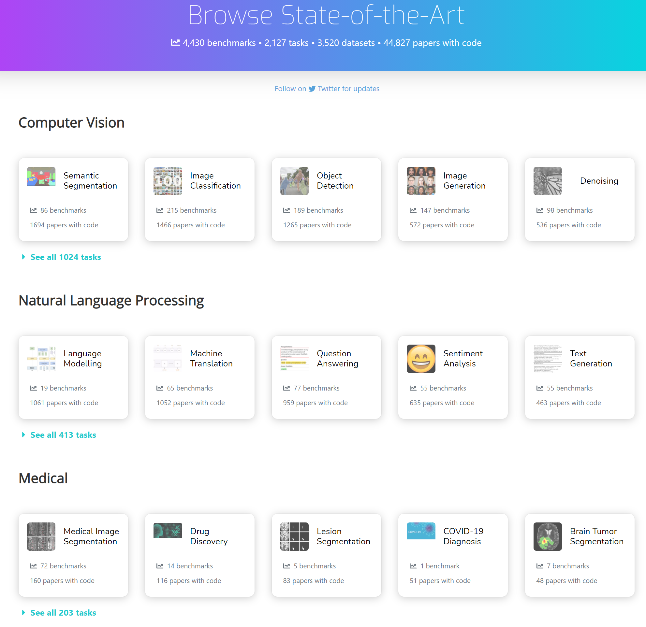
Multi-label Classification Problem with Paper Title+Abstract
paperswithcode contains 12k papers from A.I. Field
Contains “specific” A.I. Field
Some belongs to multiple areas.
Train/Valid/Test splits with 90/5/5
arxiv contains 1.7M papers from many fields
Does not contain A.I. Field
I will use this as unlabeled pool
which means … I, oracle, has to do some labe-our
1
Project Plan
area
Cogsys Lab, Daehyun Cho

Slide 6
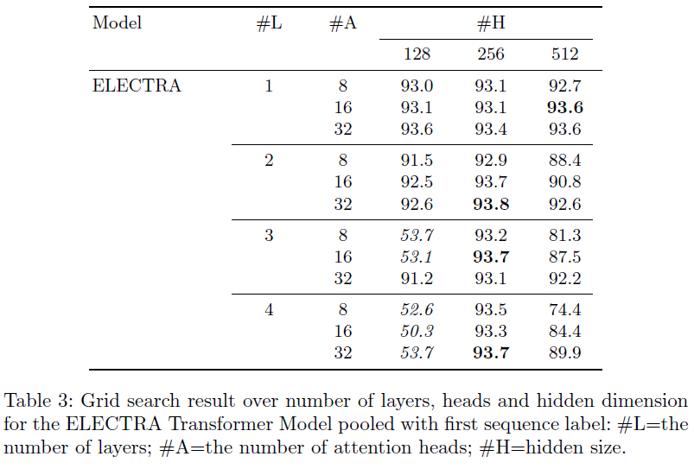
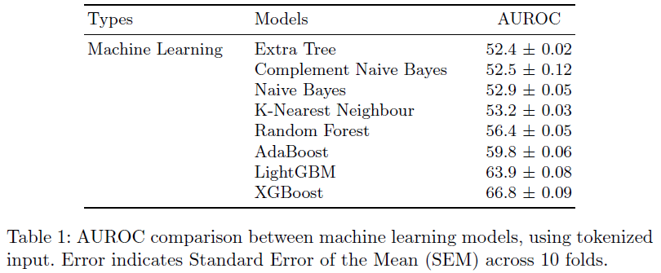
Aims to …
Achieve better results models from previous project on test set
ML Models didn’t work properly before …
Transformer models were high enough, peak around 94% but wanted to see if how far this can reach with less data
1
Project Plan
Cogsys Lab, Daehyun Cho

Slide 7
Why this project?
Why Multi-label Classification?
It was interesting that AL can do the work with small portion of data in many classification tasks by finding decision boundaries with tactic.
Wondering if multi-label classification would work too.
Why NLP?
There were some works about NLP + AL in the field, but not deeply and especially Attention models were hard to find
Also, I have some side project on this and became curious about how AL would fit in.
Why SVM / BiLSTM / BERT ?
ML models screwed up in my previous projects and wanted to see if AL works for SVM.
BiLSTM was most widely used model in NLP+AL Related works
BERT easy to implement and definitely should be tell apart with Recurrent Models
Other transformer models in candidate as well
2
Motivation
Cogsys Lab, Daehyun Cho

Slide 8
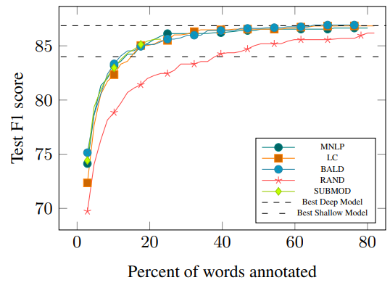
Deep active learning for named entity recognition [1]
One of early trials using Active learning in Deep learning models
Used MNLP/LC [2] sampling methods and BALD [3] and Random as baseline
This work came out before the boom of Transformers, 1dCNN and BiLSTM were used
Would be interesting to find more insight
tested on CoNLL-2003, OntoNotes-5.0 (2013)
Achieved SOTA trained with standard methods with much less data
3
Related Works
[1] Shen, Yanyao, et al. "Deep active learning for named entity recognition." arXiv preprint arXiv:1707.05928 (2017).
[2] Houlsby, Neil, et al. "Bayesian active learning for classification and preference learning." arXiv preprint arXiv:1112.5745 (2011).
[3] Settles, Burr. "Active learning literature survey." (2009).
Cogsys Lab, Daehyun Cho

Slide 9
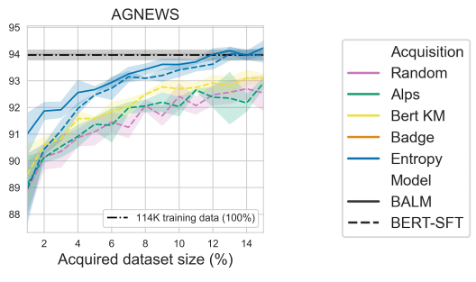
Bayesian Active Learning with Pretrained Language Models. [4]
Transformer architecture experiments with multiple AL strategy
Pretrained Models are Finetuned again in a specific task
In this finetuning stage, this work used active learning in order to achieve high performance with much less data
Compared with standard finetuning methods with multiple datasets
Within 15% of all datasets, active learning strategy surpassed the standard training options.
No acquisition strategy universally performs better
3
Related Works
[4] Margatina, Katerina, Loic Barrault, and Nikolaos Aletras. "Bayesian Active Learning with Pretrained Language Models." arXiv preprint arXiv:2104.08320 (2021).
Cogsys Lab, Daehyun Cho

Slide 10
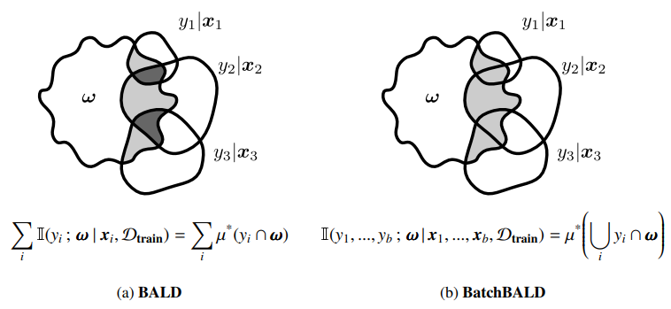
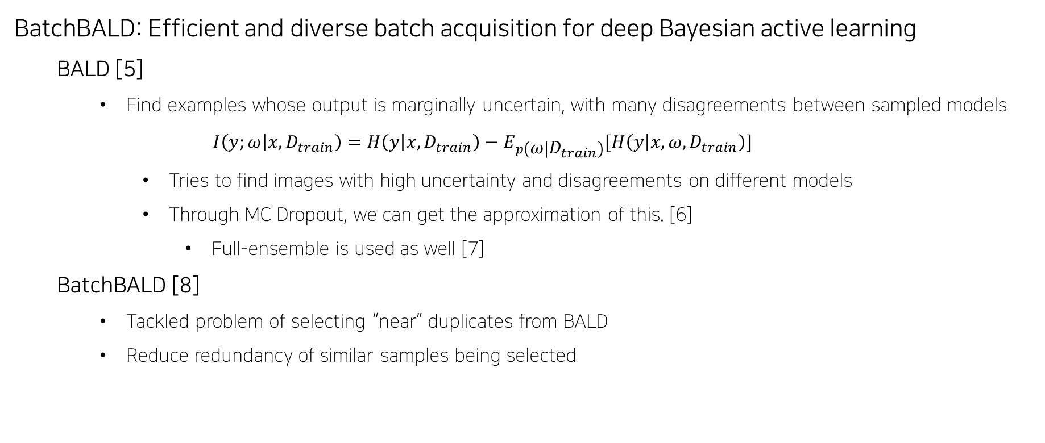
BatchBALD: Efficient and diverse batch acquisition for deep Bayesian active learning
BALD [5]
Find examples whose output is marginally uncertain, with many disagreements between sampled models
$$I\left(y;ω | x, D_{train}\right)=H\left(y | x, D_{train}\right)−E_{p\left(ω | D_{train}\right)}[H\left(y | x, ω, D_{train}\right)]$$
Tries to find images with high uncertainty and disagreements on different models
Through MC Dropout, we can get the approximation of this. [6]
Full-ensemble is used as well [7]
BatchBALD [8]
Tackled problem of selecting “near” duplicates from BALD
Reduce redundancy of similar samples being selected
3
[5] Houlsby, Neil, et al. "Bayesian active learning for classification and preference learning." arXiv preprint arXiv:1112.5745 (2011).
[6] Gal, Yarin, and Zoubin Ghahramani. "Dropout as a bayesian approximation: Representing model uncertainty in deep learning." international conference on machine learning. PMLR, 2016.
[7] Kirsch, Andreas, Joost Van Amersfoort, and Yarin Gal. "Batchbald: Efficient and diverse batch acquisition for deep bayesian active learning." Advances in neural information processing systems 32 (2019): 7026-7037.
[8] Beluch, William H., et al. "The power of ensembles for active learning in image classification." Proceedings of the IEEE Conference on Computer Vision and Pattern Recognition. 2018.
Cogsys Lab, Daehyun Cho

Slide 11
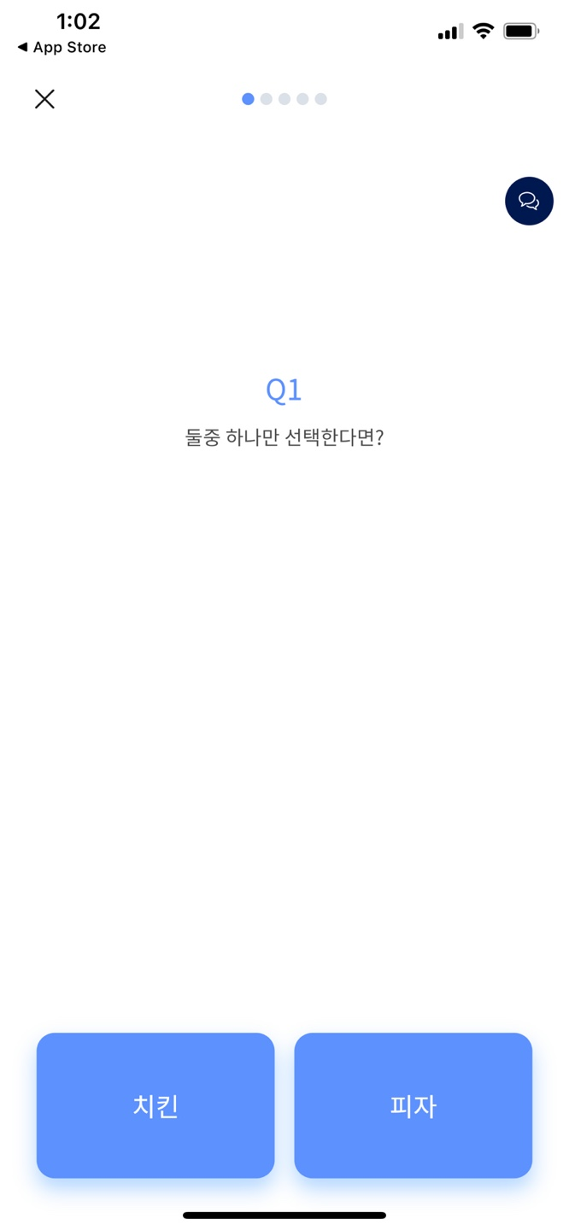
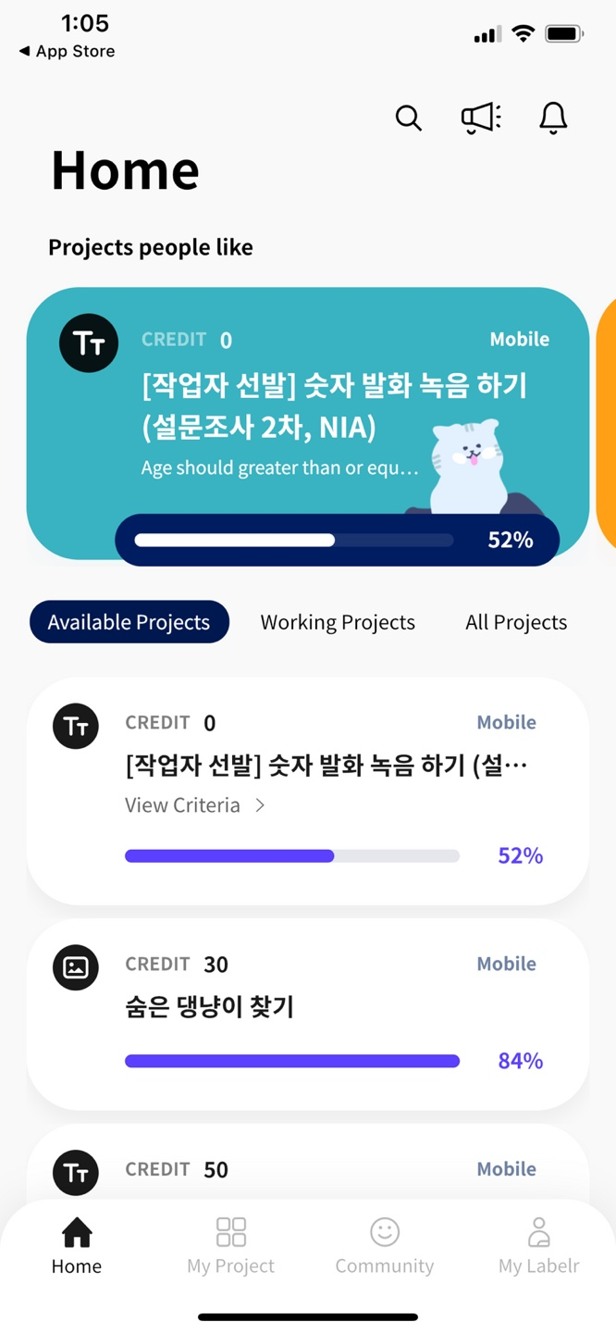
Through this project …
Similar/Same approach to novel dataset
More insight about NLP + AL
Trials with various ML/Transformer models
Domain-specific dataset
Serving (if possible)
Thinking of data annotation tool
Annotating “high uncertainty” data first would help in large amounts of data
Not going to deploy seriously, but just a mockup
4
Contributions
Cogsys Lab, Daehyun Cho

Slide 12
About Active Learning
https://minds.wisconsin.edu/bitstream/handle/1793/60660/TR1648.pdf?sequence=1
https://dsgissin.github.io/DiscriminativeActiveLearning/2018/07/05/AL-Intro.html
https://jacobgil.github.io/deeplearning/activelearning
Discriminative Active Learning
https://arxiv.org/pdf/1907.06347.pdf
https://dsgissin.github.io/DiscriminativeActiveLearning/2018/07/05/DAL.html
https://github.com/dsgissin/DiscriminativeActiveLearning
https://kmhana.tistory.com/12?category=838050
BALD
https://arxiv.org/pdf/1112.5745.pdf
https://arxiv.org/pdf/1703.02910.pdf
https://github.com/Riashat/Deep-Bayesian-Active-Learning
BatchBALD
https://arxiv.org/abs/1906.08158
https://oatml.cs.ox.ac.uk/blog/2019/06/24/batchbald.html
https://github.com/BlackHC/BatchBALD
+
References
Cogsys Lab, Daehyun Cho

Slide 13
Thank you 🙏
Questions ?
Daehyun Cho
Cogsys Lab, AI Dept
1phantasmas@korea.ac.kr
Cogsys Lab

Slide 14
+
Backups
__unused slides
Cogsys Lab

Slide 15
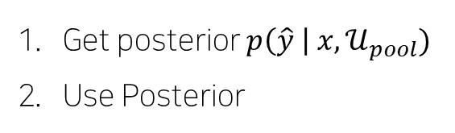
Whole Pipeline in Blueprint
3
Related Works
Get posterior $p\left(\hat{y} \right| x, 𝒰_{pool})$
Use Posterior
Cogsys Lab, Daehyun Cho

Slide 16
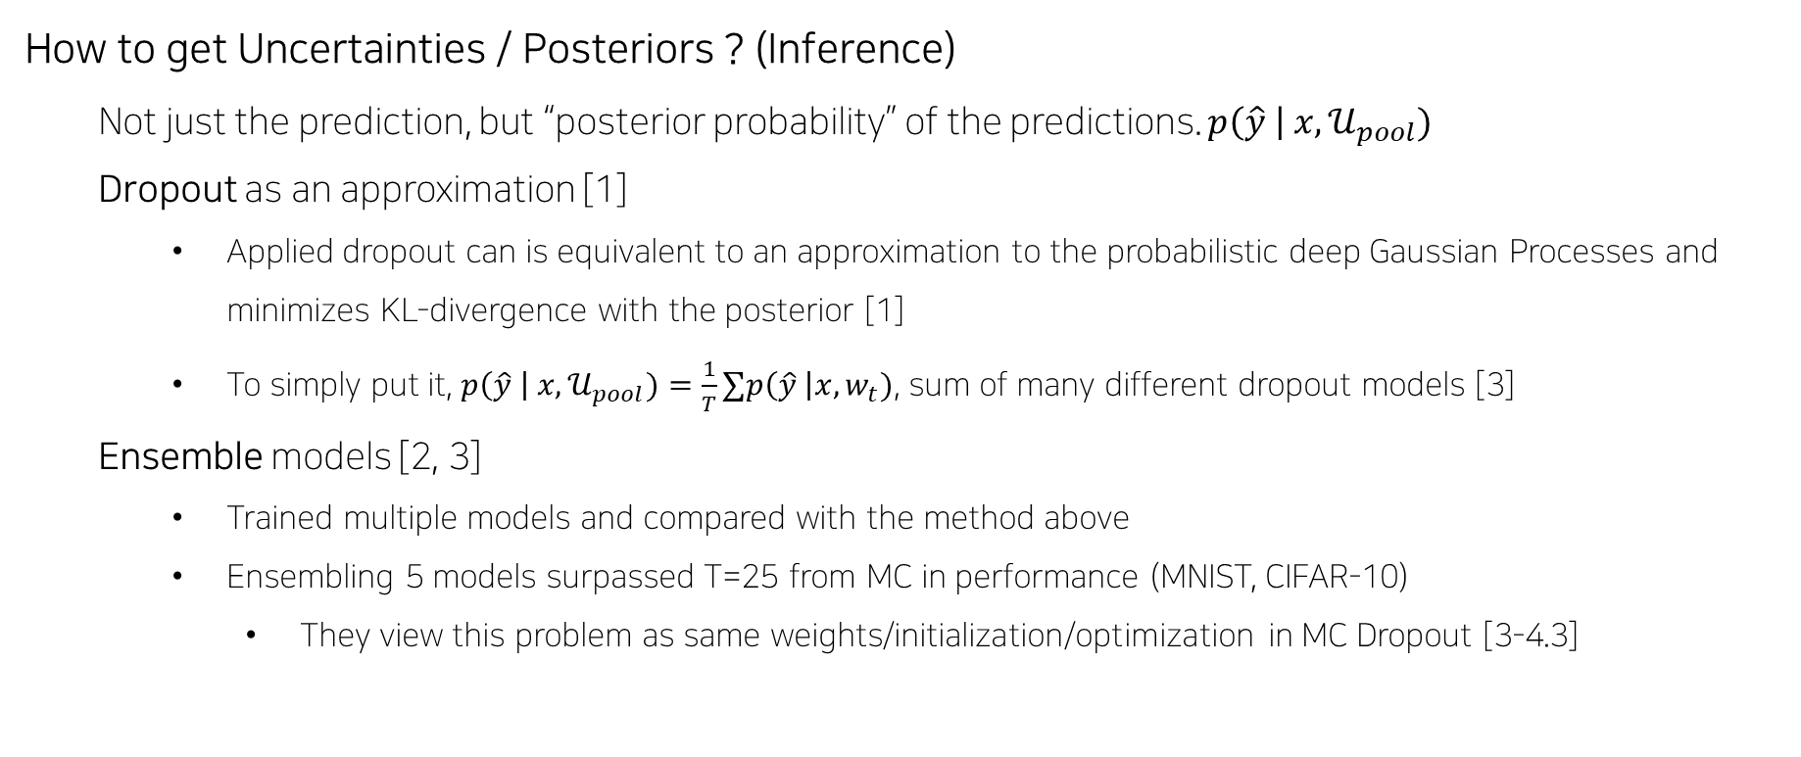
How to get Uncertainties / Posteriors ? (Inference)
Not just the prediction, but “posterior probability” of the predictions. $p\left(\hat{y} \right| x, 𝒰_{pool})$
Dropout as an approximation [1]
Applied dropout can is equivalent to an approximation to the probabilistic deep Gaussian Processes and minimizes KL-divergence with the posterior [1]
To simply put it, $p\left(\hat{y} \right| x, 𝒰_{pool})=\frac{1}{T}∑p\left(\hat{y} \right|x, w_{t})$, sum of many different dropout models [3]
Ensemble models [2, 3]
Trained multiple models and compared with the method above
Ensembling 5 models surpassed T=25 from MC in performance (MNIST, CIFAR-10)
They view this problem as same weights/initialization/optimization in MC Dropout [3-4.3]
3
Related Works
[1] Gal, Yarin, and Zoubin Ghahramani. "Dropout as a bayesian approximation: Representing model uncertainty in deep learning." international conference on machine learning. PMLR, 2016.
[2] Lakshminarayanan, Balaji, Alexander Pritzel, and Charles Blundell. "Simple and scalable predictive uncertainty estimation using deep ensembles." arXiv preprint arXiv:1612.01474 (2016).
[3] Beluch, William H., et al. "The power of ensembles for active learning in image classification." Proceedings of the IEEE Conference on Computer Vision and Pattern Recognition. 2018.
Cogsys Lab, Daehyun Cho

Slide 17
+
How to alleviate Uncertainties ?: Classic Active Learning [4]
Uncertainty Sampling
Random Sampling
Least Confidence
Margin Sampling
Query-By-Committee (QBC)
Vote Entropy
KL-Divergence
Expected Model Change (EGL)
Vote Entropy
KL-Divergence
Variance Reduction and Fisher Information Ratio (FIR)
Related Works
[4] Settles, Burr. "Active learning literature survey." (2009).
Cogsys Lab, Daehyun Cho

Slide 18
How to alleviate Uncertainties ? - for Deep Learning
Deep Learning has difficulties in - [5]
Requiring Large amounts of data
No representation about model uncertainty
Discriminative Active Learning (DAL) [6]
Select a sample that is far from learned representation
Bayesian Active Learning by Disagreement (BALD) [7]
Find examples whose output is marginally uncertain, with many disagreements between sampled models
BatchBALD [8]
Tackled problem of selecting “near” duplicates from BALD
3
Related Works
[5] Gal, Yarin, Riashat Islam, and Zoubin Ghahramani. "Deep bayesian active learning with image data." International Conference on Machine Learning. PMLR, 2017.
[6] Gissin, Daniel, and Shai Shalev-Shwartz. "Discriminative active learning." arXiv preprint arXiv:1907.06347 (2019).
[7] Houlsby, Neil, et al. "Bayesian active learning for classification and preference learning." arXiv preprint arXiv:1112.5745 (2011).
[8] Kirsch, Andreas, Joost Van Amersfoort, and Yarin Gal. "Batchbald: Efficient and diverse batch acquisition for deep bayesian active learning." Advances in neural information processing systems 32 (2019): 7026-7037.
Cogsys Lab, Daehyun Cho

Slide 19
Applications to Natural Language Processing tasks ?
1dCNN / LSTM / CRF + AL
LC / MNLP / BALD Sampling on NER – SOTA with much less data [9]
LC / Dropout+BALD / Backprop-by-Bayes on few tasks [10]
SC: no significance / NER, SRL: with 50% of the dataset, outperforms w/o AL
BERT + AL
BERT Finetune on Unlabeled Pool gives performs better than standard BERT Finetuning [11]
In real-world challenging scenario, AL can improve model performance [12]
BERT Classification task with AL performs well [13]
No single strategy outperforms the other [12, 13]
3
Related Works
[9] Shen, Yanyao, et al. "Deep active learning for named entity recognition." arXiv preprint arXiv:1707.05928 (2017).
[10] Siddhant, Aditya, and Zachary C. Lipton. "Deep bayesian active learning for natural language processing: Results of a large-scale empirical study." arXiv preprint arXiv:1808.05697 (2018).
[11] Margatina, Katerina, Loic Barrault, and Nikolaos Aletras. "Bayesian Active Learning with Pretrained Language Models." arXiv preprint arXiv:2104.08320 (2021).
[12] Dor, Liat Ein, et al. "Active learning for BERT: An empirical study." Proceedings of the 2020 Conference on Empirical Methods in Natural Language Processing (EMNLP). 2020.
[13] Prabhu, Sumanth, Moosa Mohamed, and Hemant Misra. "Multi-class Text Classification using BERT-based Active Learning." arXiv preprint arXiv:2104.14289 (2021).
Cogsys Lab, Daehyun Cho

Slide 20
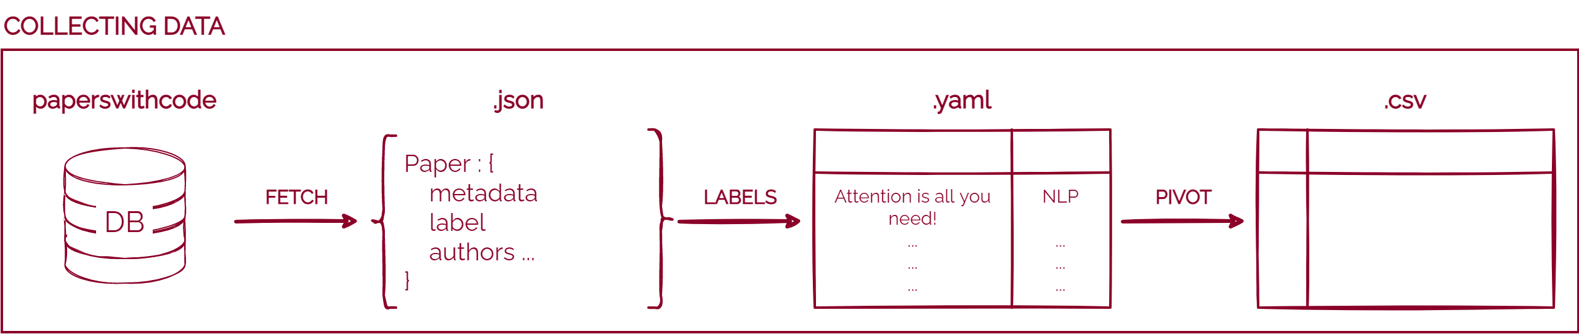
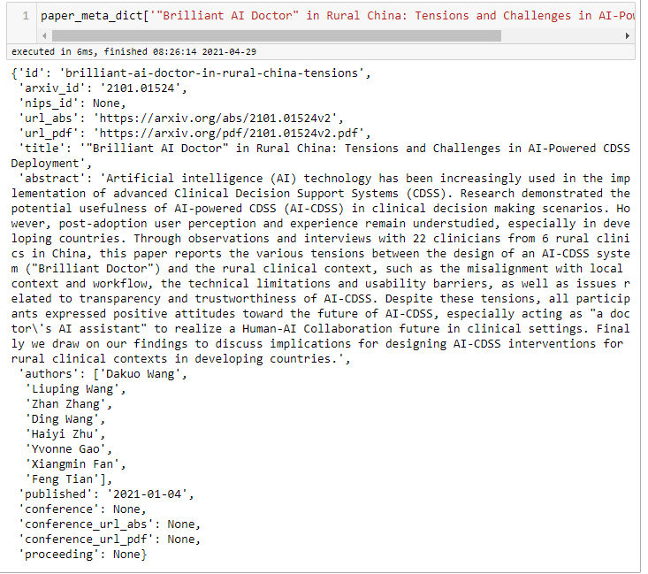
+
Paperswithtopic Data Collection Pipeline
Experiments
Use paperswithcode Database
Database page made with Django library with their domain open
Everyone can fetch data here!
There is an open API made by them, but does not work
I partially used their open-source code to scrape the data
Fetching and Organizing Data
Right figure is the raw meta-data fetched from the DB
Here I only used ‘title’ and ‘area’
‘area’ is not seen on the figure since papers were scraped by area
Fig. 1 Raw Meta Data for each paper
Cogsys Lab, Daehyun Cho

Slide 21
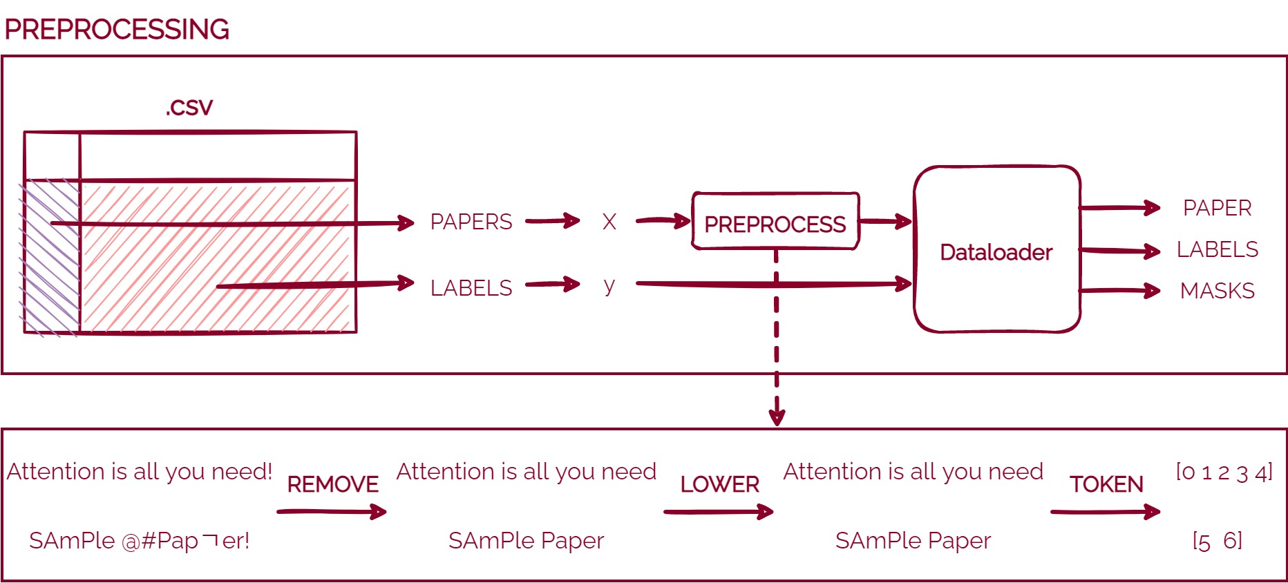
+
Preprocessing
Experiments
Make correct X, y
Preprocessing is the most important part in NLP
I only leaved Alphabets and Numbers
Chinese, Special characters were all removed
Lowered the alphabets
Tokenized by word
Embedding
This can be done with many ways, such as –
sentencepiece, word2vec, FastText
Possible to remove tenses (plural, past tense e.t.c)
Word embeddings
But we can also expect deep learning to do that as well.
Cogsys Lab, Daehyun Cho

Slide 22
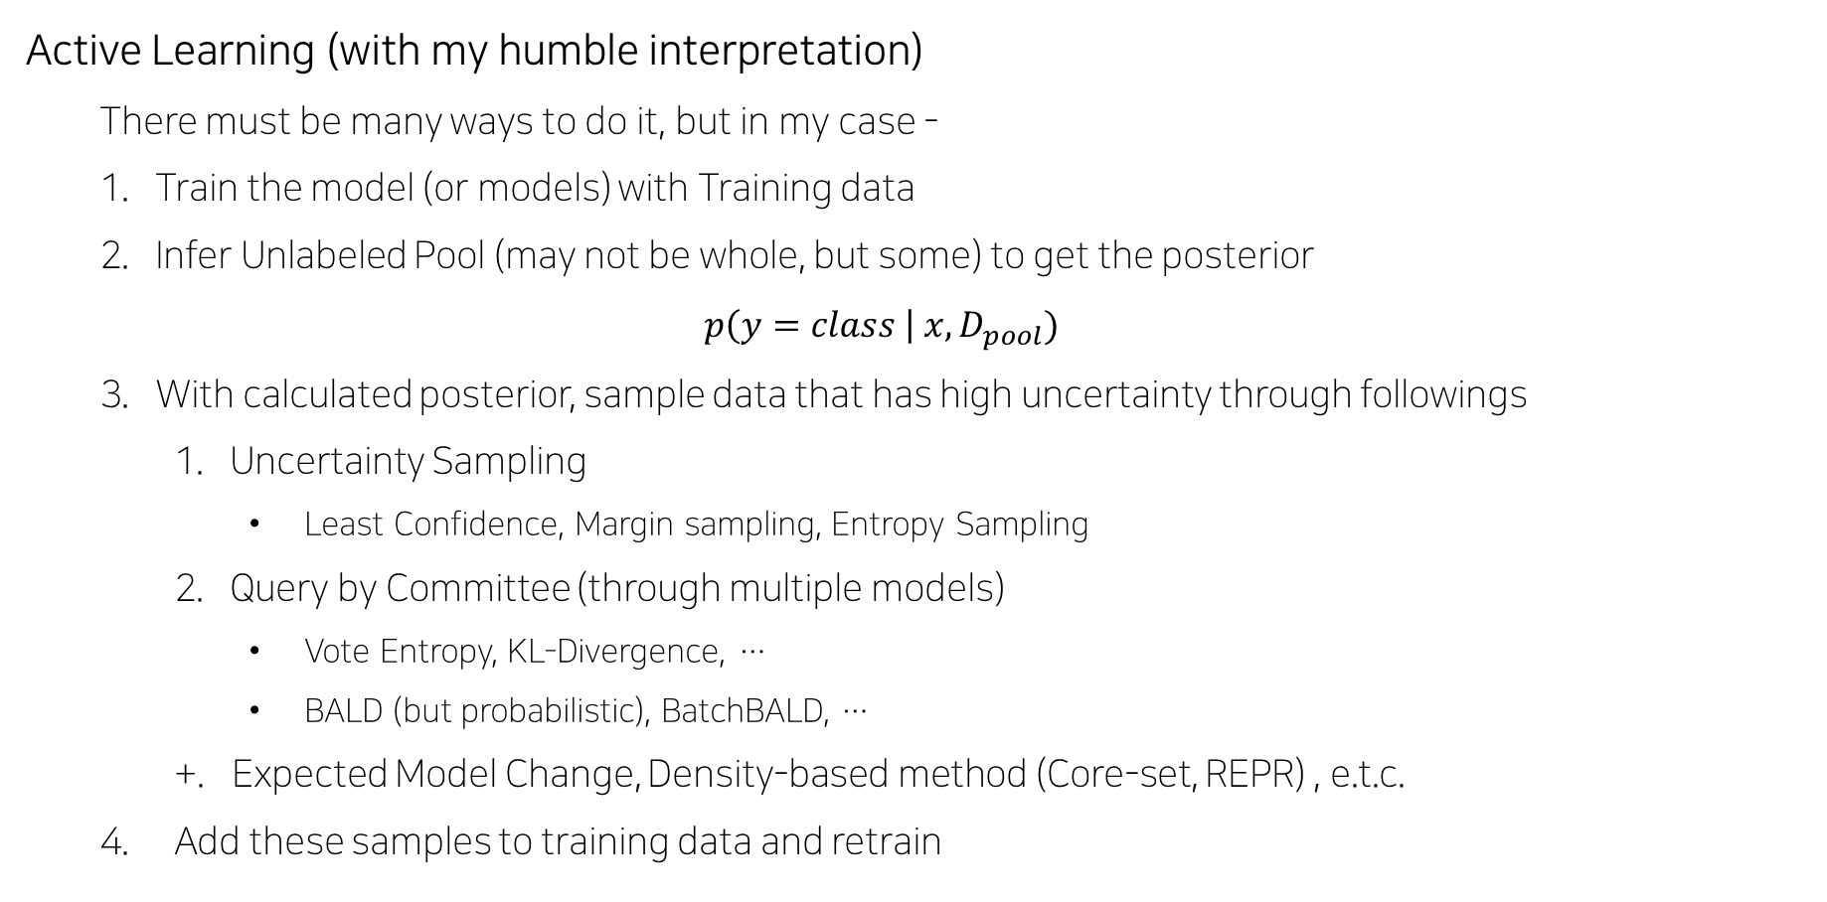
+
Active Learning (with my humble interpretation)
There must be many ways to do it, but in my case -
Train the model (or models) with Training data
Infer Unlabeled Pool (may not be whole, but some) to get the posterior $p\left(y=class \right| x, D_{pool})$
With calculated posterior, sample data that has high uncertainty through followings
Uncertainty Sampling
Least Confidence, Margin sampling, Entropy Sampling
Query by Committee (through multiple models)
Vote Entropy, KL-Divergence, …
BALD (but probabilistic), BatchBALD, …
+. Expected Model Change, Density-based method (Core-set, REPR) , e.t.c.
Add these samples to training data and retrain
Cogsys Lab, Daehyun Cho

